Slide 1
FITNESS MANAGEMENT system
NAME : PRATHAM SHAH
ROLL NO : 64
ENROLL.NO : 22002170110168
BRANCH : CE

Slide 2
INTRODUCTION
User have to insert their data regarding to their body/health and by that details all the important details such as bmi, bmr, protein requirement will be calculated and that will also be stored.
Further you have to select your workout plan, there is one specialized plan which is of some costing and if you want to buy it you have to pay for it by upi .
There are some specialized diet plan that will be based on your requirement like to maintain weight or weight gain or for weight loss.
Graphical representation for the calories burned and workouts.

Slide 3
CONCEPTS
Polymorphism :- By implementing different class and methods for specific task.
Importing Modules: This code imports the random, os, datetime, numpy, and matplotlib.pyplot modules to perform tasks related to random number generation, numerical operations, and plotting graphs.
File Handling: File operations such as reading from files (open, read) and writing to files (write, close) are utilized throughout the code..
List and Dictionary: Lists are used to store calorie intake and calorie burned values. A dictionary is used to store protein values for different food items.
Exception handling :- By catch any exception in the program.

Slide 4
FUNCTIONALITIES
Class Definition: Defines a class for health and fitness information encapsulation.
File Handling: Reads and writes data to manage user information and subscriptions.
Conditional Statements: Validates user inputs and executes actions based on conditions.
Function Definitions: Organizes code into functions for specific functionalities.
Module Importing: Imports modules for additional functionalities like random number generation and data visualization.
User Authentication: Ensures secure access with username/password validation
Health Data Analysis: Computes BMI, BMR, and protein requirements for personalized health insights.
Workout Planning: Provides personalized workout schedules for users.
Calorie Visualization: Displays calorie intake and burned data using graphs for better understanding.

Slide 5
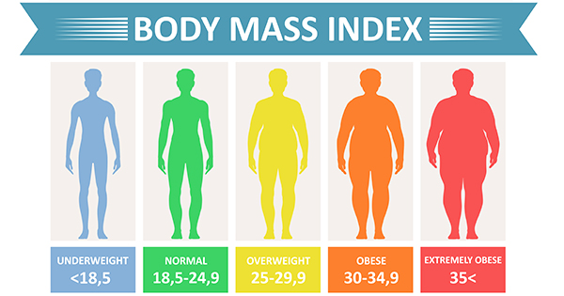
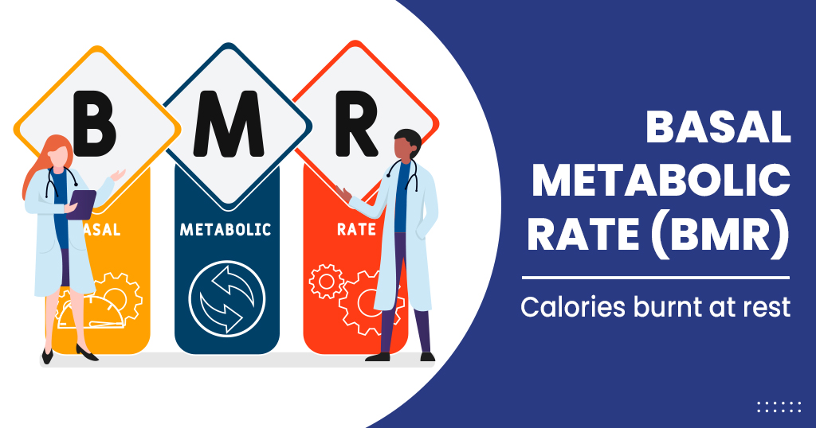
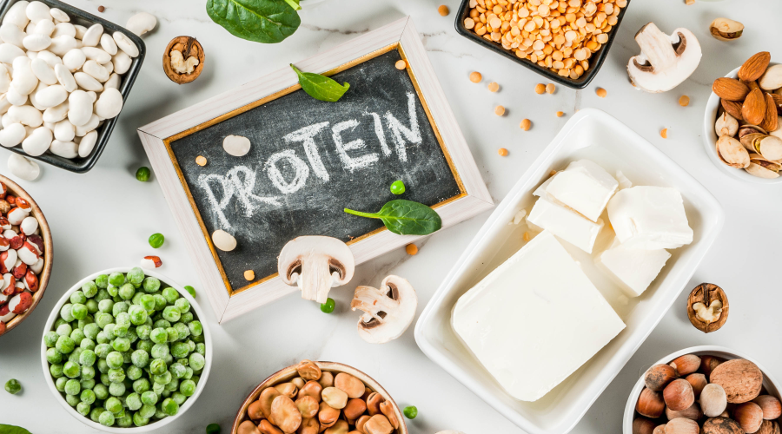
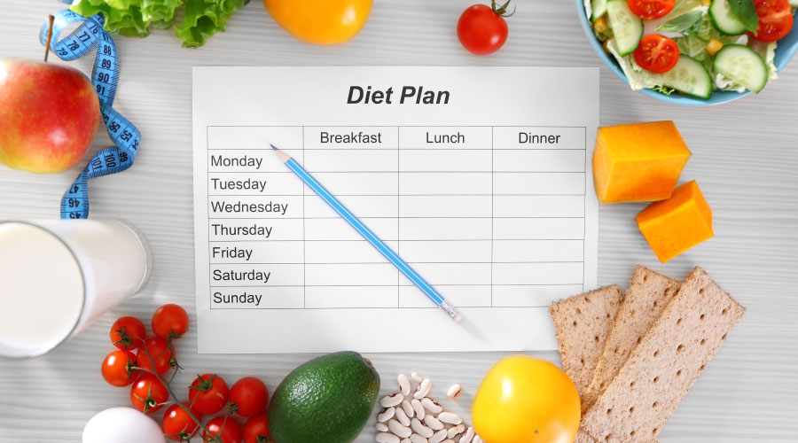

Main components
BMI
BMR
PROTEIN REQUIREMENT
DIET PLAN
WORKOUT PLAN

Slide 6
MERITS AND DEMERITS
Merits
Demerits
Lack of graphical user interface.
Complexity and dependencies from external modules.
Organized and modular code structure.
Ensures data integrity with file handling.
Seamless user interaction through input/output operations.
Offers personalized recommendations for users.

Slide 7
FUTURE SCOPE
Graphical user interface will be added to this.
Development of mobile applications for broader accessibility.
Integration with wearable devices for real-time data tracking.
Implementation of social features for community engagement

Slide 8
Thank you

